Slide 1
William Stallings
Computer Organization and Architecture
8th Edition
Chapter 6
External Memory

Slide 2
Types of External Memory
Disk substrate coated with magnetisable material
(iron oxide)
Substrate used to be aluminium Now glass
  Improved surface uniformity (Increases reliability)
  Reduction in surface defects (Reduced read/write errors)
  Lower flight heights
  Better stiffness
  Better shock/damage resistance
Magnetic Disk
  RAID
  Removable
Optical
  CD-ROM
  CD-Recordable
  (CD-R)
  CD-R/W
  DVD
Magnetic Tape

Slide 3
Terms for Sizes of Memory or CPU Cycles
2¹⁰ = Kilo Thousand = 10³
2²⁰ = Mega Million = 10⁶
2³⁰ = Gega Billion = 10⁹
2⁴⁰ = Tera Trillion = 10¹²
2⁵⁰ = Peta Quadrillion = 10¹⁵
2⁶⁰ = Exa Quintillion = 10¹⁸
2⁷⁰ = Zetta Sextillion = 10²¹
2⁸⁰ = Yotta Septillion = 10²⁴

Slide 4
Read and Write Mechanisms
Recording & retrieval via conductive coil called a head
May be single read/write head or separate ones
During read/write, head is stationary, platter rotates
Write
  Current through coil produces magnetic field
  Pulses sent to head
  Magnetic pattern recorded on surface below
Read (traditional)
  Magnetic field moving relative to coil produces current
  Coil is the same for read and write
Read (contemporary)
  Separate read head, close to write head
  Partially shielded magneto resistive (MR) sensor
  Electrical resistance depends on direction of magnetic field
  High frequency operation
    Higher storage density and speed

Slide 5
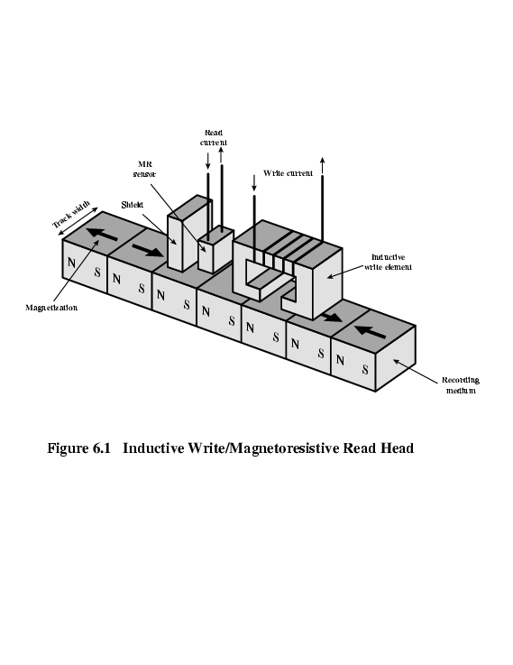
Inductive Write MR Read, Data Organization and Formatting (Zone, Track, Block, Sector)
Concentric rings or tracks
  Gaps between tracks
  Reduce gap to increase capacity
  Same number of bits per track (variable packing density)
  Constant angular velocity
Tracks divided into sectors
Minimum block size is one sector
May have more than one sector per block

Slide 6
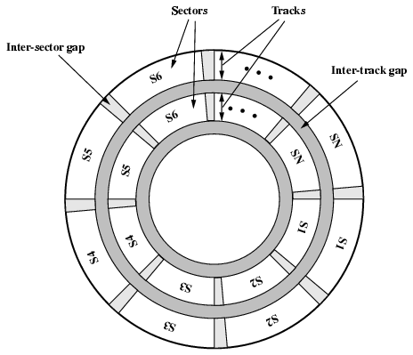
Disk Data Layout (Zone, Track, Block, Sector)

Slide 7
Disk Velocity
Bit near centre of rotating disk passes fixed a point slower than bit on outside of disk
Increase spacing between bits in different tracks
Rotate disk at constant angular velocity (CAV)
  Gives pie shaped sectors and concentric tracks
  Individual tracks and sectors addressable
  Move head to given track and wait for given sector
  Waste of space on outer tracks
    Lower data density
Can use zones to increase capacity
  Different zone have different bits per track
  Each zone has fixed bits per track
  More complex circuitry

Slide 8
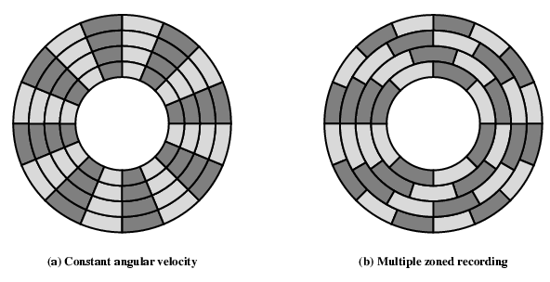
Disk Layout Methods Diagram

Slide 9
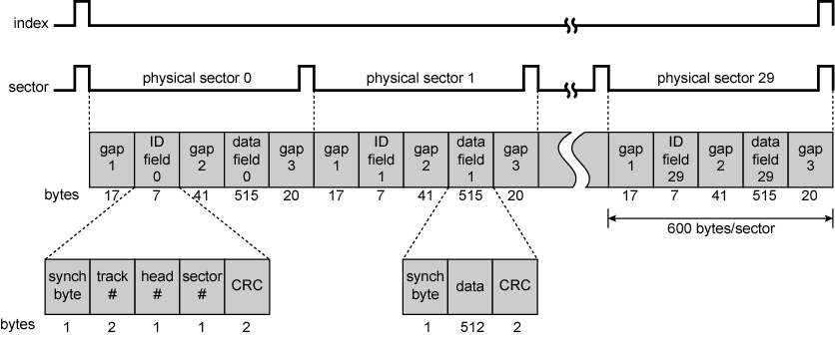
Finding Sectors
Must be able to identify start of track and sector
Format disk
  Additional information not available to user
  Marks tracks and sectors
  Total bytes = 600 per sector
  Winchester Disk Format (Seagate ST506)

Slide 10
Characteristics of Disk Drives
Drive: fixed in the system (rare) or movable
Disk: Removable or fixed
Head Mechanism: {Contact (Floppy), Fixed gap, Flying (Winchester)} Used Surface: Single or double (usually) sided
No. of Disks: Single or multiple platter
    Heads aligned => fixed on fixture => 1 mechanism & circuit
    Cylindrical view of drives disks
    Striped Data => less movement => fast transfer

Slide 11
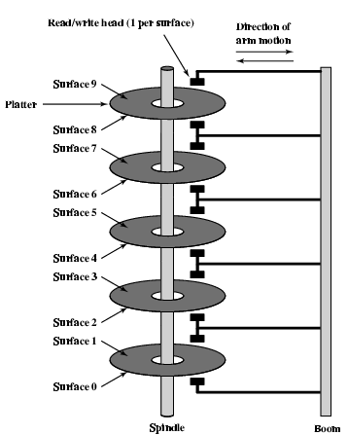
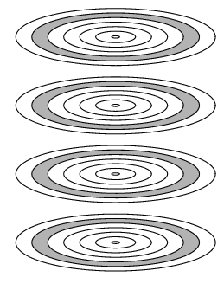
Multiple Platters, Tracks & Cylinders

Slide 12
Winchester Hard Disk
Developed by IBM in Winchester (USA)
Sealed unit
One or more platters (disks)
Heads fly on boundary layer of air as disk spins
Very small head to disk gap
Getting more robust
Universal
Cheap
Fastest external storage
Getting larger all the time
  250 Gigabyte now easily available

Slide 13
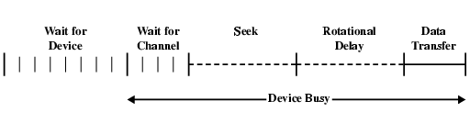
Speed : Timing of Disk I/O Transfer
Seek time (-Moving head to correct track)
(Rotational) latency (-Waiting for data to rotate under head)
Access time = Seek + Latency
T =b/rN Transfer Time: The transfer time to or from the disk depends on the rotation speed of the disk on the following parameters:
b number of bytes to be transferred
N number of bytes on a track
r rotation speed, in revolutions per second
T_{a} Thus the total average access time can be expressed as
T_{a} = T_{s} + 1/2r + b/rN
T_{s} is average seek time for a zone. Zoned drive make it difficult to calculate.

Slide 14
RAID : Redundant Array of Independent Disks
Redundant Array of Inexpensive Disks
6 levels in common use
(Not a hierarchy. Have following characteristics)
Set of physical disks viewed as single logical drive by O/S to increase read write speed using striped storage of data. (RAID 0)
Data stored redundantly on multiple drives to mirror data for recovery from drive failure (RAID 1)
Can use redundant capacity to store parity information for data error recovery (RAID 2)

Slide 15
RAID 0, RAID 1, RAID 2,
RAID 0: No redundancy, Data striped across all disks, Round Robin striping, Increase speed but also data loss chances
  Multiple data requests probably not on same disk
  Disks seek in parallel increase data speed
  A set of data is likely to be striped across multiple disks
RAID 1: Mirrored Disks, Data is striped across disks, 2 copies of each stripe on separate disks, Read from either, Write to both, Recovery is simple, But Expensive write
  Swap faulty disk & re-mirror
  No down time
RAID 2: Disks are synchronized, Very small (byte/word level) stripes, Error correction calculated across corresponding bits on disks, Multiple parity disks store Hamming code error correction in corresponding positions. Lots of redundancy
  Expensive
  Less used

Slide 16
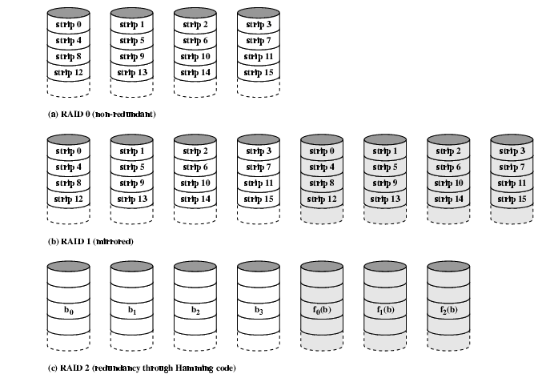
RAID 0, 1, 2

Slide 17
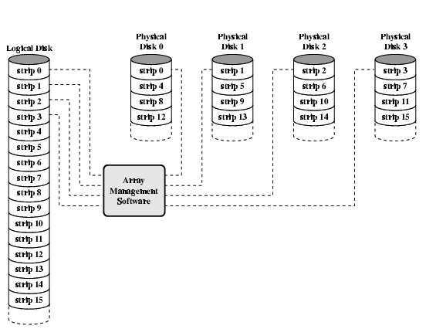
Data Mapping For RAID 0

Slide 18
RAID 3, RAID 4:
RAID 3: Similar to RAID 2, Only one redundant disk, no matter how large the array
Simple parity bit for each set of corresponding bits, Data on failed drive can be reconstructed from surviving data and parity info, Very high transfer rates
RAID 4: Each disk operates independently
Good for high I/O request rate, Large stripes
Bit by bit parity calculated across stripes on each disk, Parity stored on parity disk

Slide 19
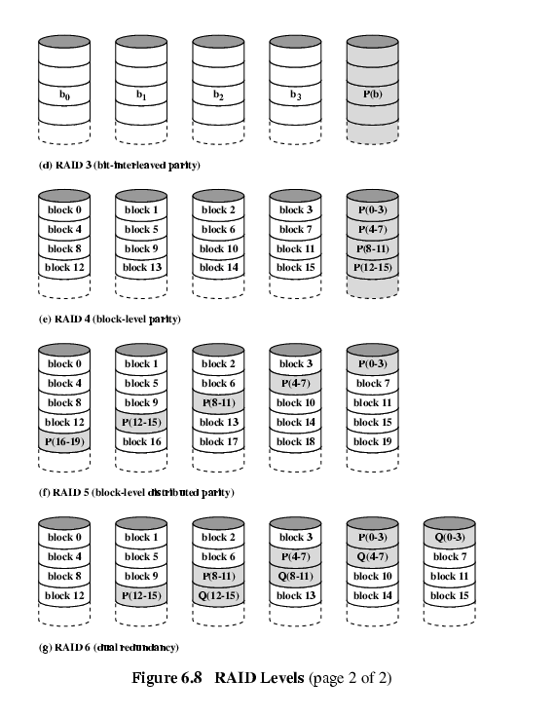
RAID 3 & 4

Slide 20
RAID 5(Not always 5 Disks), RAID 6
RAID 5: is Like RAID 4,
Parity striped across all disks
Round robin allocation for parity stripe
Avoids RAID 4 bottleneck at parity disk
Commonly used in network servers
RAID 6: Two parity calculations
Stored in separate blocks on different disks
User requirement of N disks needs N+2
High data availability
  Three disks need to fail for data loss
  Significant write penalty

Slide 21
RAID 5 & 6

Slide 22
Optical Storage CD-ROM
Originally for audio
650Mbytes giving over 70 minutes audio
Polycarbonate coated with highly reflective coat, usually aluminium
Data stored as pits
Read by reflecting laser
Constant packing density
Constant linear velocity

Slide 23
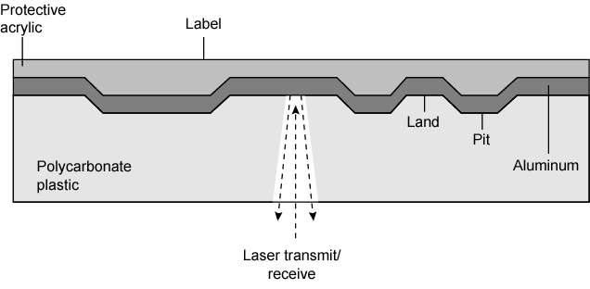
CD Operation

Slide 24
CD-ROM Drive Speeds
Audio is single speed
  Constant linier velocity
  1.2 ms⁻¹
  Track (spiral) is 5.27km long
  Gives 4391 seconds = 73.2 minutes
Other speeds are quoted as multiples
e.g. 24x
Quoted figure is maximum drive can achieve

Slide 25
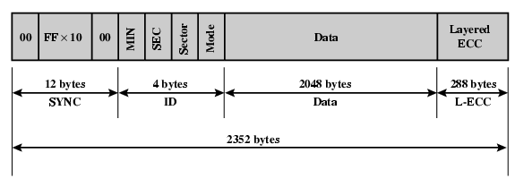
CD-ROM Format
Mode 0=blank data field
Mode 1=2048 byte data+error correction
Mode 2=2336 byte data

Slide 26
Random Access on CD-ROM
Difficult
Move head to rough position
Set correct speed
Read address
Adjust to required location
(Yawn!)

Slide 27
CD-ROM for & against
Large capacity (?)
Easy to mass produce
Removable
Robust
Expensive for small runs
Slow
Read only

Slide 28
Other Optical Storage
CD-Recordable (CD-R)
  WORM
  Now affordable
  Compatible with CD-ROM drives
CD-RW
  Erasable
  Getting cheaper
  Mostly CD-ROM drive compatible
  Phase change
    Material has two different reflectivities in different phase states

Slide 29
DVD - what’s in a name?
Digital Video Disk
  Used to indicate a player for movies
    Only plays video disks
Digital Versatile Disk
  Used to indicate a computer drive
    Will read computer disks and play video disks

Slide 30
DVD - technology
Multi-layer
Very high capacity (4.7G per layer)
Full length movie on single disk
  Using MPEG compression
Finally standardized (honest!)
Movies carry regional coding
Players only play correct region films
Can be “fixed”

Slide 31
DVD – Writable
Loads of trouble with standards
First generation DVD drives may not read first generation DVD-W disks
First generation DVD drives may not read CD-RW disks
Wait for it to settle down before buying!

Slide 32
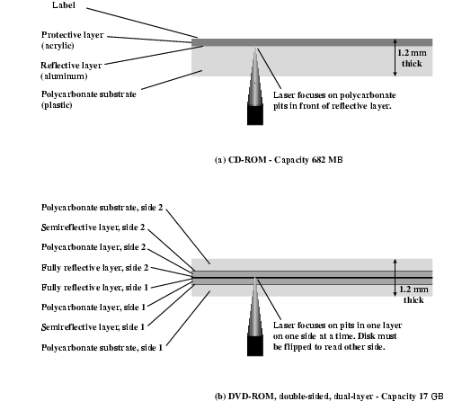
CD and DVD

Slide 33
High Definition Optical Disks
Designed for high definition videos
Much higher capacity than DVD
  Shorter wavelength laser
    Blue-violet range
  Smaller pits
HD-DVD
  15GB single side single layer
Blue-ray
  Data layer closer to laser
    Tighter focus, less distortion, smaller pits
  25GB on single layer
  Available read only (BD-ROM), Recordable once (BR-R) and re-recordable (BR-RE)

Slide 34
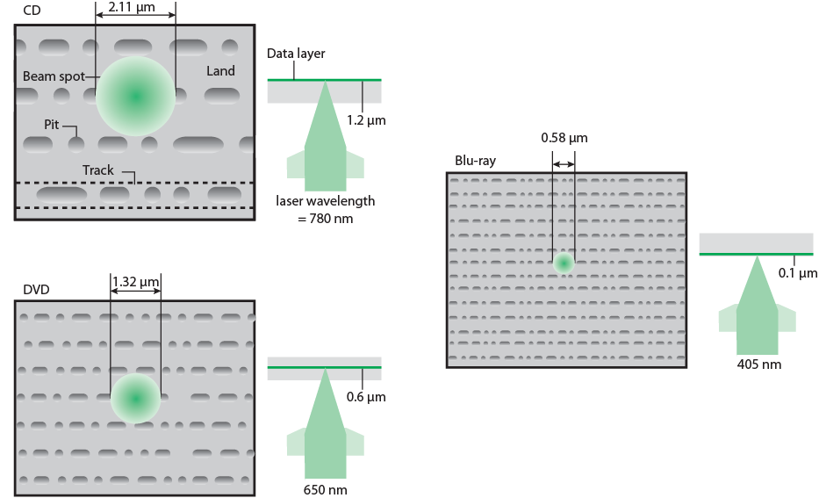
Optical Memory Characteristics

Slide 35
Magnetic Tape
Serial access
Slow
Very cheap
Backup and archive
Linear Tape-Open (LTO) Tape Drives
  Developed late 1990s
  Open source alternative to proprietary tape systems

Slide 36
Linear Tape-Open (LTO) Tape Drives
 | LTO-1 | LTO-2 | LTO-3 | LTO-4 | LTO-5 | LTO-6
Release date | 2000 | 2003 | 2005 | 2007 | TBA | TBA
Compressed capacity | 200 GB | 400 GB | 800 GB | 1600 GB | 3.2 TB | 6.4 TB
Compressed transfer rate (MB/s) | 40 | 80 | 160 | 240 | 360 | 540
Linear density (bits/mm) | 4880 | 7398 | 9638 | 13300
Tape tracks | 384 | 512 | 704 | 896
Tape length | 609 m | 609 m | 680 m | 820 m
Tape width (cm) | 1.27 | 1.27 | 1.27 | 1.27
Write elements | 8 | 8 | 16 | 16

